Slide 1

Project 1-1:
Implementing Asymmetric Cryptosystem
EL2001: Mathematical Foundation of Computer Science
Notes:
Today’s title is the overview of running programs in computer systems.

Slide 2
Goal
The implementation will be evaluated on Nov. 9 (Mon) in the class, with a simple interview
You are going to implement the cryptographic protocol as a team (two students per team)
You will implement asymmetric cryptosystems including RSA, the Diffie-Hellman (DH) key exchange, and also the symmetric encryption
You will understand what the cryptographic protocol is and how mathematical concepts are applied in the real world
You will get the deep understanding of RSA and DH
You will understand how to verify the public parameters based on what we learned in our course
  Testing the primality and verifying the generator
You will improve your coding skill on mathematical concepts
You will improve your coding skill as a team using Github

Slide 3
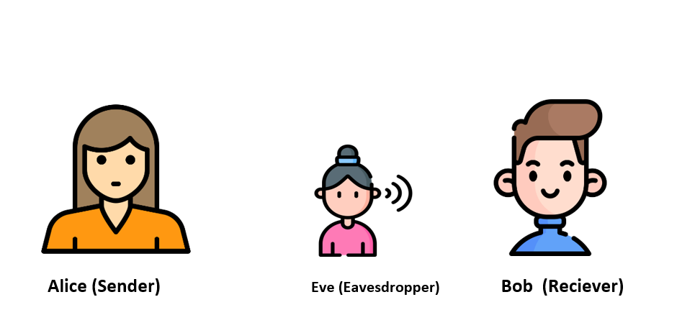
Protocol I
You need to implement the following protocol between two parties:
Run
Run
{“opcode”:0, “type”: “RSAKey”}
The RSA private key
Generate RSA keypair
{“opcode”:0, “type”: “RSAKey”, “private”: 17279,
“public”: 204335, “parameter”: {“p”: 499, “q”: 487}}
Generate the reply with the prime numbers and the keys
The RSA public key
Conduct the primality test on p and q respectively
Verify the RSA keypair
Alice
Bob
Print the keypair with their correctness
The prime number (p and q) must be between 400 and 500

Slide 4
Protocol II
You need to implement the following protocol between two parties:
Get an input message / Run
Get an input message / Run
{“opcode”:0, “type”: “RSA”}
The RSA public key
Generate RSA keypair
{“opcode”:1, “type”: “RSA”, “public”: 164063, “parameter”: {“n”: 213793}}
Generate a reply that contains n and e
Fetch n and e
The prime number (p and q) must be between 400 and 500
Generate a random symmetric key
Encrypt the random symmetric key based on RSA
Alice
The RSA encryption is done per one letter, resulting in a list
Bob

Slide 5
Protocol II (cont’d)
AES-ECB 256-bit
You need to implement the following protocol between two parties:
The RSA-encrypted symmetric key
{“opcode”:2, “type”: “RSA”, “encrypted_key”: [189924, 237239, …, 20808]}
Fetch the encrypted key
Decrypt the RSA-encrypted symmetric key
Encrypt the input message (e.g., “hello”) based on AES with the symmetric key
Bob
Alice
Encode the AES-encrypted message in Base64

Slide 6
Protocol II (cont’d)
AES-ECB 256-bit
You need to implement the following protocol between two parties:
The base64-encoded
AES-encrypted input message
{“opcode”:2, “type”: “AES”, “encryption”: “88CC1…”}
Decode the base64-encoded AES-encrypted message
Decrypt the AES-encrypted message with the symmetric key and print it
Encrypt the input message (e.g., “world”) based on AES with the symmetric key
Alice
Bob
Encode the AES-encrypted message in Base64

Slide 7
Protocol II (cont’d)
AES-ECB 256-bit
You need to implement the following protocol between two parties:
The base64-encoded
AES-encrypted input message
{“opcode”:2, “type”: “AES”, “encryption”: “319BA…”}
Decode the base64-encoded AES-encrypted message
Decrypt the AES-encrypted message with the symmetric key and print it
Bob

Slide 8
Protocol III
The prime number must be between 400 and 500 / AES-ECB 256-bit
You need to implement the following protocol between two parties:
Get an input message / Run
{“opcode”:0, “type”: “DH”}
Get an input message / Run
Bob’s DH public key
Generate the DH keypair
{“opcode”:1, “type”: “DH”, “public”: …, “parameter”: {“p”: …, “g”: …}}
Conduct the primality test on the received prime number
The DH shared secret must be encoded as bytes by using to_bytes(2, byteorder=“big”)
Verify whether the received g is the correct generator
Generate the DH keypair
Alice
Then, repeat it to make 32 bytes; for instance, if two bytes are 0102, then the result is 0102 0102 0102 0102 0102 0102 0102 0102 0102 0102 0102 0102 0102 0102 0102 0102
Bob
Generate the DH shared secret
Extract the AES key from the DH shared secret

Slide 9
Protocol III (cont’d)
The prime number must be between 400 and 500 / AES-ECB 256-bit
You need to implement the following protocol between two parties:
Alice’s DH public key
{“opcode”:1, “type”: “DH”, “public”: …}
Generate the DH shared secret
Extract the AES key from the DH shared secret
The DH shared secret must be encoded as bytes by using to_bytes(2, byteorder=“big”)
Encrypt the input message (e.g., “hello”) based on AES with the symmetric key
Bob
Alice
Then, repeat it to make 32 bytes; for instance, if two bytes are 0102, then the result is 0102 0102 0102 0102 0102 0102 0102 0102
Encode the AES-encrypted message in Base64

Slide 10
Protocol III (cont’d)
The prime number must be between 400 and 500 / AES-ECB 256-bit
You need to implement the following protocol between two parties:
The base64-encoded
AES-encrypted input message
{“opcode”:2, “type”: “AES”, “encryption”: “88CC1…”}
Decode the base64-encoded AES-encrypted message
Decrypt the AES-encrypted message with the symmetric key and print it
Encrypt the input message (e.g., “world”) based on AES with the symmetric key
Alice
Bob
Encode the AES-encrypted message in Base64

Slide 11
Protocol III (cont’d)
The prime number must be between 400 and 500 / AES-ECB 256-bit
You need to implement the following protocol between two parties:
The base64-encoded
AES-encrypted input message
{“opcode”:2, “type”: “AES”, “encryption”: “FEDCB…”}
Decode the base64-encoded AES-encrypted message
Decrypt the AES-encrypted message with the symmetric key and print it
Bob

Slide 12
Protocol IV-I
The prime number must be between 400 and 500 / AES-ECB 256-bit
You need to implement the following protocol between two parties:
Get an input message / Run
{“opcode”:0, “type”: “DH”}
Get an input message / Run
Bob’s DH public key
Generate the DH keypair
{“opcode”:1, “type”: “DH”, “public”: …, “parameter”: {“p”: non-prime number, “g”: …}}
Encode the DH
public key in Base64
Conduct the primality test on the received prime number
{“opcode”:3, “error”: “incorrect prime number”}
Print the error message and quit the application
Print the received error message
Alice
Bob

Slide 13
Protocol IV-II
The prime number must be between 400 and 500 / AES-ECB 256-bit
You need to implement the following protocol between two parties:
Get an input message / Run
{“opcode”:0, “type”: “DH”}
Get an input message / Run
Bob’s DH public key
Generate the DH keypair
{“opcode”:1, “type”: “DH”, “public”: …, “parameter”: {“p”: …, “g”: non-generator}}
Encode the DH
public key in Base64
Conduct the primality test on the received prime number
Verify whether the received g is the correct generator
Alice
{“opcode”:3, “error”: “incorrect generator”}
Bob
Print the error message and quit the application
Print the received error message

Slide 14
Messages (1/3)
The messages between Alice and Bob must be encoded in the JSON format, which is widely used on the Internet
The specification for the message formats in the protocols are as follows:
JSON key | Type | Values | Description
opcode | integer | 0 | The message that contains a request
 |  | 1 | The message that contains keys or parameters
 |  | 2 | The message that contains encrypted messages
type | string | RSAKey | The message is related to the RSA key generation
 |  | RSA | The message is related to the RSA encryption/decryption protocol
 |  | DH | The message is related to the DH protocol

Slide 15
Messages (2/3)
The messages between Alice and Bob must be encoded in the JSON format, which is widely used on the Internet
The specification for the message formats in the protocols are as follows:
JSON key | Type | Values | Description
public | integer | base64-encoded string | public key (the type of the public key must be specified with “type”)
encryption | string | base64-encoded string | encrypted message (the type of the algorithm used to encrypt the message must be specified with “type”)
parameter | JSON | JSON object with integers | parameters (the type of the related algorithm must be specified with “type”) for RSA, there must be p and q, for DH, there must be p and g

Slide 16
Messages (3/3)
The messages between Alice and Bob must be encoded in the JSON format, which is widely used on the Internet
The specification for the message formats in the protocols are as follows:
JSON key | Type | Values | Description
encrypted_key | JSON list | RSA-encrypted key bytes | RSA-encrypted key bytes (32 elements)

Slide 17
Evaluation
The evaluation will be made based on communications between your implementation and the test applications
The skeleton code can be found at:
https://github.com/hw5773/math-project-2026.git
Your implementations will be tested as follows (the following are examples):
You, as a server, may receive a non-prime number or a non-generator during the DH key exchange
You, as a client, may receive a symmetric key through the RSA encryption
The implementation will be evaluated on Nov. 9 (Mon) in the class, with a simple interview

Slide 18
Rubric
Each team will have a default score of 18 (or 16) and gets points based on
how you achieves the tasks as follows:
Criteria | 2 | 1 | 0
Role distribution (interview) | A team defines roles and distributes roles well to all the team members | A team somehow defines and distributes roles well to all the team members | The roles are not well defined and distributed
RSA key generation | The protocol I is implemented correctly | Either RSA key generation or verification works correctly | RSA key generation does not work correctly
RSA encryption/decryption | The protocol II is implemented correctly | Either RSA encryption or decryption works correctly | Neither RSA encryption nor decryption works
DH key exchange (normal) | The protocol III is implemented correctly | Either DH key generation or DH shared secret generation works correctly | Neither DH key generation nor DH shared secret generation works
DH error control | The protocol IV is implemented correctly | Either the primality test or the generator verification works correctly | Neither the primality test nor the generator verification works correctly
Implementation | A team’s implementations are managed well using Github | A team only use Github to upload the final implementations | A team’s implementations are not managed well using Github
The team with 5 members MUST implement additional two variants of the primality test functions and compare the elapsed time of them

Slide 19
Additional Task
You can do the additional tasks if you want
You will have addition 1 point if you succeed in implementing either of two attacks in the next slides
The detail will be announced again
The maximum additional point is only 1 point; that is, even if you implement two attacks, you will get 1 point

Slide 20

Additional Task I
You can implement the passive attacker who can decrypt the messages between Alice and Bob in the middle on Protocol II
{“opcode”:0, “type”: “RSA”}
{“opcode”:1, “type”: “RSA”, “public”: “9EAB1…”, “parameter”: {“n”: …}}
{“opcode”:2, “type”: “RSA”, “encryption”: “A0325…”}
{“opcode”:2, “type”: “AES”, “encryption”: “88CC1…”}
{“opcode”:2, “type”: “AES”, “encryption”: “FEDCB…”}
Alice
Bob
Eve

Slide 21
Additional Task II
You can implement the passive attacker who can decrypt the messages between Alice and Bob in the middle on Protocol III
{“opcode”:0, “type”: “DH”}
{“opcode”:1, “type”: “DH”, “public”: “9EAB1…”, “parameter”: {“p”: …, “g”: …}}
{“opcode”:1, “type”: “DH”, “public”: “A0325…”}
{“opcode”:2, “type”: “AES”, “encryption”: “88CC1…”}
{“opcode”:2, “type”: “AES”, “encryption”: “FEDCB…”}
Alice
Bob
Eve

